Slide 1
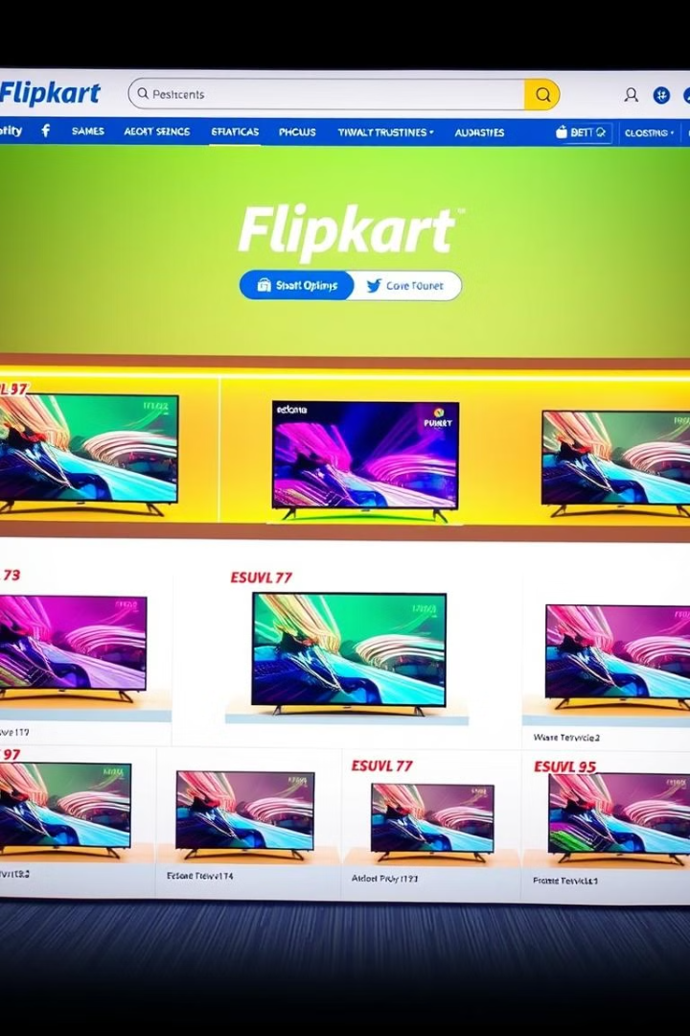
Flipkart TV Data Analysis: From Web Scraping to Visualization
This project explores the process of extracting, cleaning, and analyzing TV data from the popular e-commerce platform Flipkart using web scraping techniques in Python. The insights gained are then visualized in Power BI to uncover key trends and patterns.
bb
by bharathi bk

Slide 2

Introduction to Web Scraping with Python
1
Automating Data Extraction
2
Diverse Data Sources
Web scraping can be applied to a wide range of websites, providing access to a wealth of information.
Web scraping allows for the automated extraction of data from websites, bypassing the need for manual data entry.
3
Python's Web Scraping Libraries
Tools like BeautifulSoup and Requests make the web scraping process straightforward and efficient in Python.

Slide 3
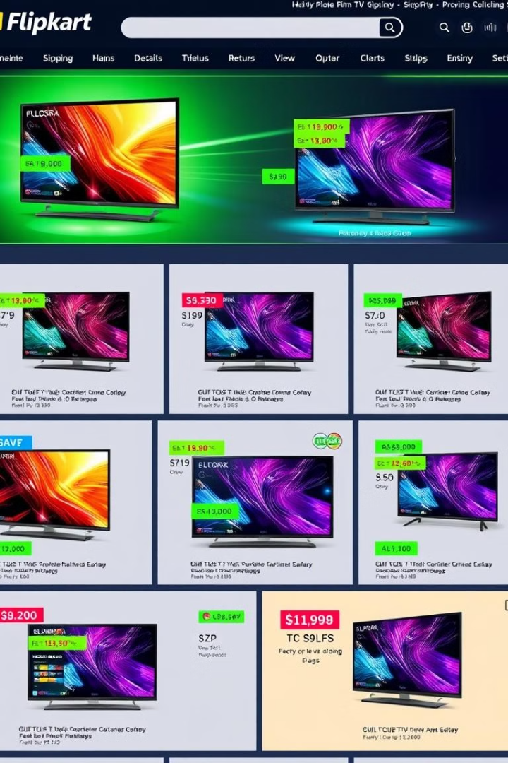
Extracting Data from Flipkart using BeautifulSoup
1
Identify Target URLs
Determine the specific URLs on the Flipkart website that contain the TV product data to be extracted.
2
Fetch HTML Content
Use the Requests library to retrieve the HTML content of the target pages.
3
Parse HTML with BeautifulSoup
Leverage BeautifulSoup to navigate the HTML structure and extract the desired TV data.

Slide 4
Data Cleaning and Preprocessing in Python
Data Transformation
Missing Value Handling
Outlier Detection
Detect and handle outliers in the dataset to ensure the reliability and accuracy of the analysis.
Convert data types, handle inconsistent formatting, and perform necessary transformations to prepare the data for analysis.
Identify and address missing data points using techniques like imputation or dropping rows with incomplete information.

Slide 5

Handling Missing Values and Outliers
Missing Value Imputation
Outlier Removal
Implement methods like IQR or standard deviation-based thresholds to identify and remove outliers from the dataset.
Leverage techniques like mean, median, or mode imputation to fill in missing data points.
Handling Categorical Data
Data Validation
Perform thorough checks to ensure the cleaned dataset is complete, consistent, and ready for analysis.
Address missing values and outliers in categorical variables through techniques like one-hot encoding or label encoding.

Slide 6

Integrating Data into a MySQL Database
1
Create Database and Table
Set up a MySQL database and define a table structure to store the Flipkart TV data.
2
Insert Data into Table
Use Python's database connectivity libraries to seamlessly insert the cleaned data into the MySQL table.
3
Verify Data Integrity
Perform checks to ensure the data has been correctly stored and can be accessed through SQL queries.

Slide 7
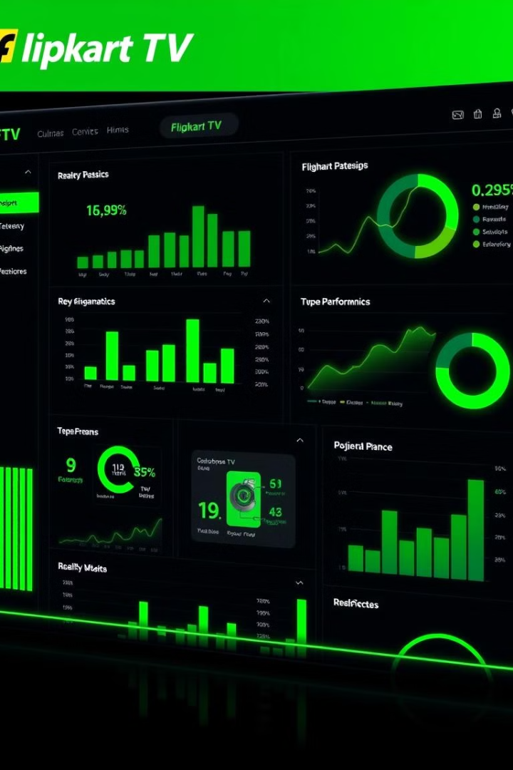



Visualizing the Data in Power BI
Bar Charts
Visualize quantitative data and comparisons between different variables.
Line Charts
Depict trends and patterns over time, highlighting changes in data points.
Donat Charts
Showcase the proportional breakdown of categorical data, such as market share.

Slide 8



Identifying Key Insights and Trends
Top-Selling TV Models
Identify the most popular TV models based on sales volume and revenue.
Price Sensitivity Analysis
Investigate the relationship between TV prices and customer demand.

Slide 9

Conclusion and Future Opportunities
1
Insights Gained
2
Business Implications
The analysis has uncovered valuable insights about Flipkart's TV product performance and customer preferences.
These insights can inform strategic decision-making and help Flipkart optimize their TV product offerings.
3
Future Opportunities
The project demonstrates the power of web scraping and data analysis, paving the way for further exploration and innovation.

